Slide 1
Group ID: 17
-Group Members-
Aakash Manjrekar (17101A0071)
Atharvan Chavan (18101A2001)
Siddhesh Shivgan (18101A2007)
-Under the Guidance of-
Prof. Vinita Bhandiwad

Slide 2
Topic:
Smart Car Parking System

Slide 3
INTRODUCTION
The main aim is to design an integrated system which involves two components namely Parking Allocation and Seamless Parking.
The Parking Allocation component consists of sensors in front each slot and when a vehicle enters into the slot, the database is updated and the changes are reflected immediately on the Mobile Application.
The seamless parking component consists of a RFID Tag with user. It will save the time of human intervention and saving an ample amount of time. The IR senses the presence of a vehicle in the parking slot and updates the database.

Slide 4
PROBLEM STATMENT
Problem Definition: Nowadays in many public places such as malls, multiplex systems, hospitals, offices, market areas there is a crucial problem of car parking.
Proposed Solution: The main objective is to avoid the cramming in the car parking area by implementing an efficient car parking system along with a user-friendly application for an ease of use.

Slide 5
PROPOSED METHODOLOGY
Check RFID Card / Tag.
Give permission to enter on the basis of RFID authentication.
Check for empty parking slots.
Detect new vehicle entry.
Count the parking time.
Send this data to firebase.
Display real time data on application.

Slide 6
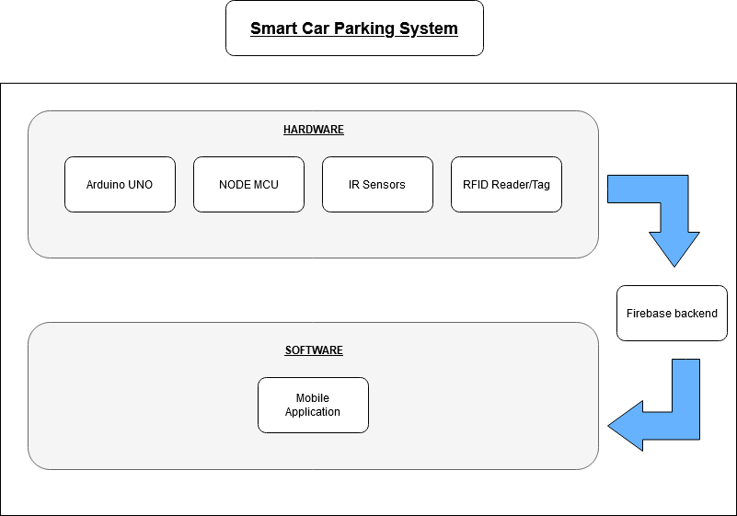
BLOCK DIAGRAM

Slide 7
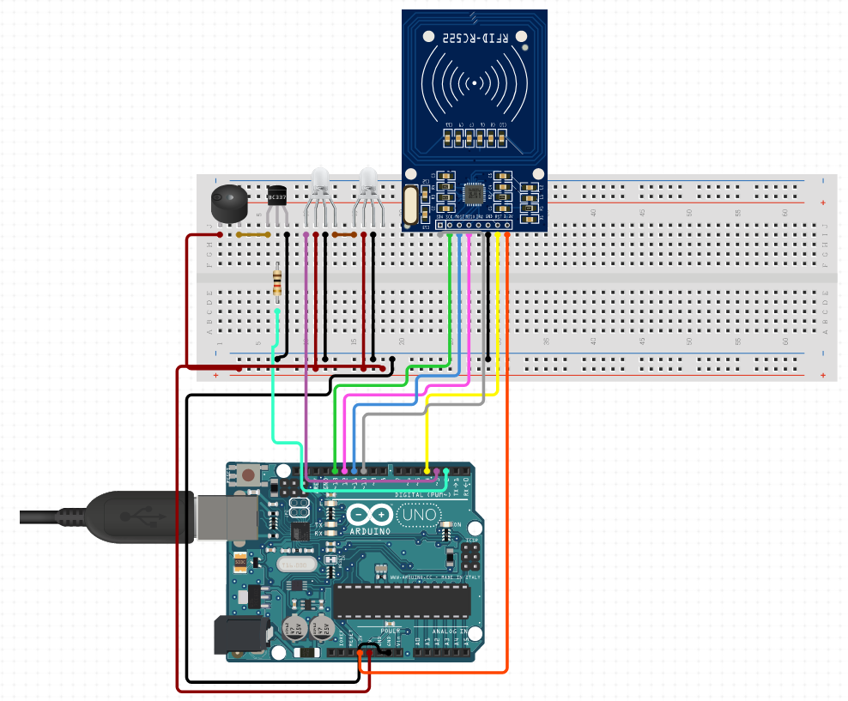
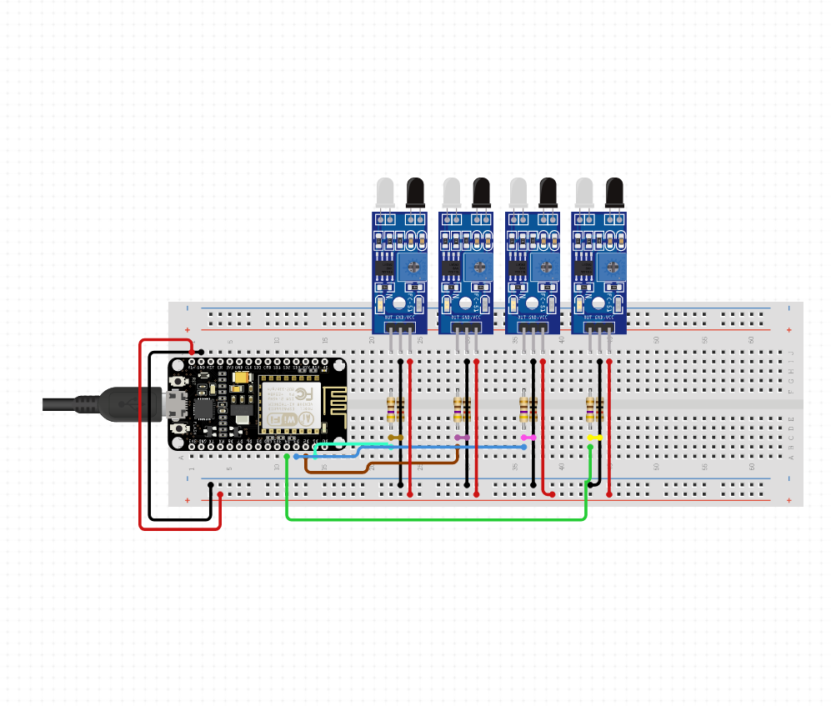
CIRCUIT DIAGRAMS
Citizen
Admin
Fig 1:RFID Module
Fig 2:IR Sensor Module

Slide 8
COMPONENTS
HARDWARE :
Arduino UNO R3.
NodeMCU ESP8266.
RFID RC522 Reader / Tags.
Breadboard.
Jumper Wires.
4 IR Sensors.
2 LED Lights (Red and Green).
Buzzer.
SOFTWARE :
Arduino IDE.
Flutters Frameworks.
Dart.
Firebase.

Slide 9
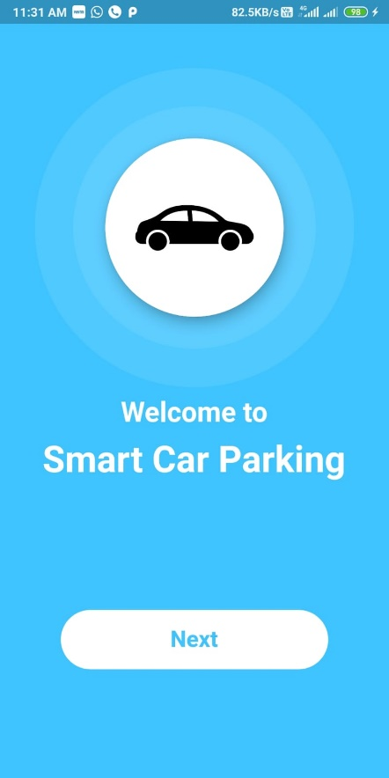
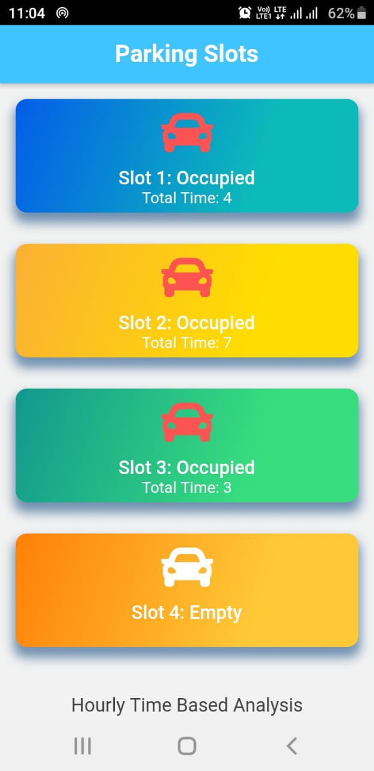
IMPLEMENTATION
Welcome Screen
Homepage

Slide 10
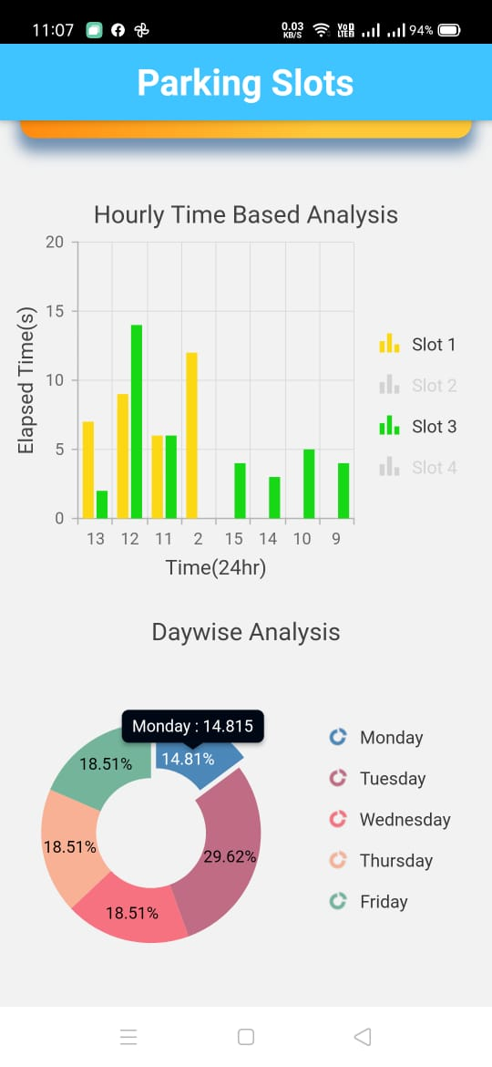
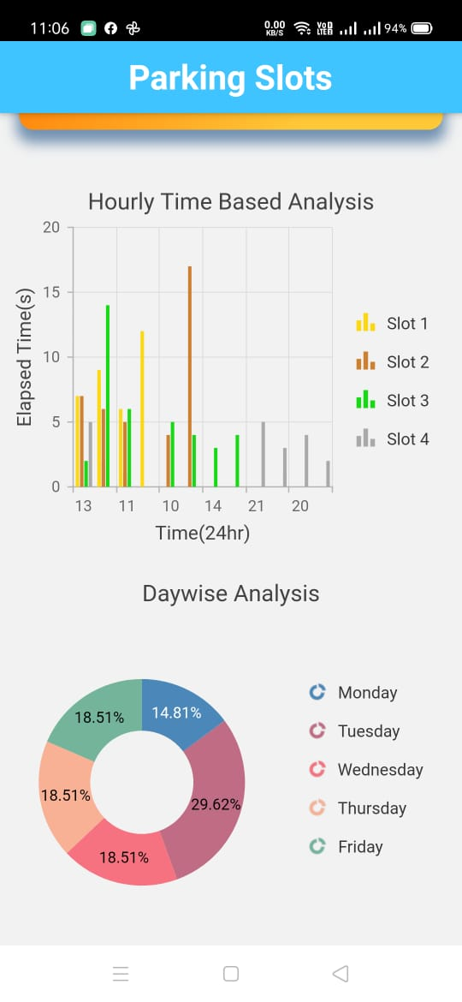
IMPLEMENTATION
Graph Analysis
Piechart Analysis

Slide 11
CONCLUSION
In the Smart Car Parking System, the users are guided to the vacant slot for parking by showing the empty slots on our app that we have developed, Our App show a visual representation of the parking lot with empty and occupied slots which are green and red respectively. The user is provided with a tag which he receives on registration. This would reduce the human efforts and time with additional comfort.

Slide 12
REFERENCES
[1] Karma Tsheten Dorjee , Deepak Rasaily , Bishal Cintury
,RFID-Based Automatic Vehicle Parking System Using Microcontroller,IJETT,Volume 32 , Number 4, February
2016.
[2] R.Kannadasan, A.Krishnamoorthy, N.Prabakaran, K.Naresh, V.Vijayarajan, G.Sivashanmugam,RFID Based Automatic Parking System , Australian journal of basic and Applied Sciences , Volume 10(2) ,Pages: 186- 191,February 2016.
[3] S. C. Hanche, Pooja Munot, Pranali Bagal, Kirti Sonawane & Pooja Pise, Automated Vehicle Parking System using RFID, ISSN (PRINT) : 2320 – 8945, Volume -1, Issue -2, 2013.
[4] Lanxin Wei; Qisheng Wu; Mei Yang; Wei Ding; Bo Li; Rong Gao ,Design and Implementation of Smart Parking Management System Based on RFID and Internet, Pages: 17 - 20, Year: 2012.
[5] Kartha, V., George, L., Tomy, A., Mathew, F., Shenoy,
M. and K, A. (2017). Interfacing EM-18 RFID Reader Module with Raspberry Pi. [online] electroSome. Available at: https://electrosome.com/em-18-rfid-reader- raspberry-pi/.

Slide 13
THANK YOU

